Slide 1
Predicting Apple Stock Prices with LSTM
Dazheng Zhu
2024/10/14
https://github.com/zac4j/stock-market-analysis

Slide 2
Introduction
This project aims to develop a machine learning model using Long Short-Term Memory (LSTM) networks to predict future Apple stock prices.
The model will be trained on historical Apple stock price data, after data preprocessing and feature engineering, the LSTM model will be trained and evaluated using appropriate metrics.
The goal is to create a model that can accurately predict future stock prices based on past trends and patterns.

Slide 3
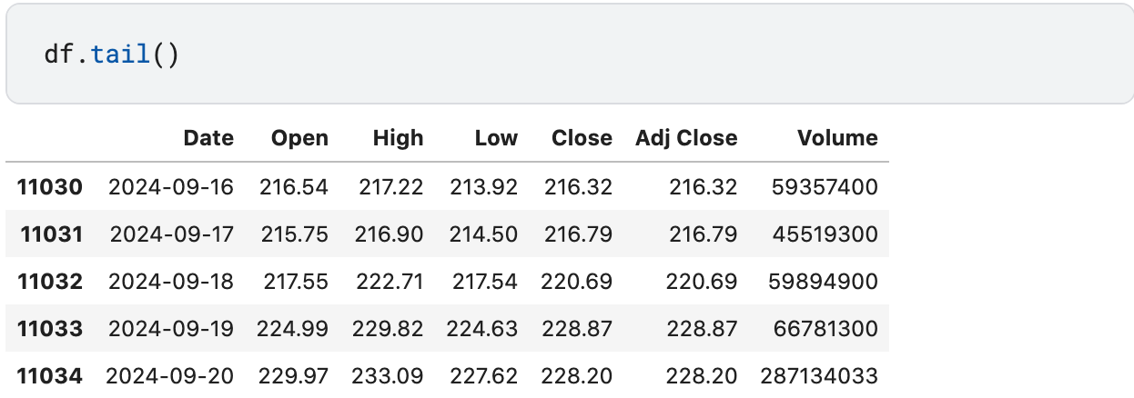
Data
Data Source: Apple Stocks Data - Latest 21 September, 2024 dataset from the Kaggle.

Slide 4
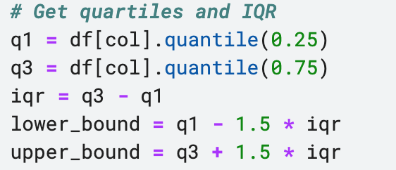
Data Preprocessing
Data Cleaning: Identifying Missing Values, Outliers, and Incorrect Data Types in a DataFrame
e.g. We'll use the Interquartile Range (IQR) method to identify outliers in each column of our dataset. This method is robust to outliers and is commonly used for outlier detection.

Slide 5
Data Preprocessing
Result:
Numerical Outliers DataFrame: {'Open': 2, 'High': 2, 'Low': 0, 'Close': 0, 'Adj Close': 0, 'Volume': 47}
Percentage Outliers DataFrame: {'Open': '0.20%', 'High': '0.20%', 'Low': '0.00%', 'Close': '0.00%', 'Adj Close': '0.00%', 'Volume': '4.61%'}
Analysis:
Retain the above outliers, these outliers are valid exterme values that are not erros, removing them might distort the dataset's distribution and lead to inaccurate conclusion.

Slide 6
Feature Engineering
Feature Engineering: OHLC prices and Volume are fundamental data points in stock market analysis.
By applying feature engineering techniques, we can derive valuable new features that can enhance predictive models and provide deeper insights into stock price behavior.
New Features:
Moving Averages: Simple Moving Average (SMA), Exponential Moving Average (EMA).
Relative Strength Index (RSI): Measures the speed and change of price movements.
Moving Average Convergence Divergence (MACD): Compares two moving averages to identify trend changes.

Slide 7
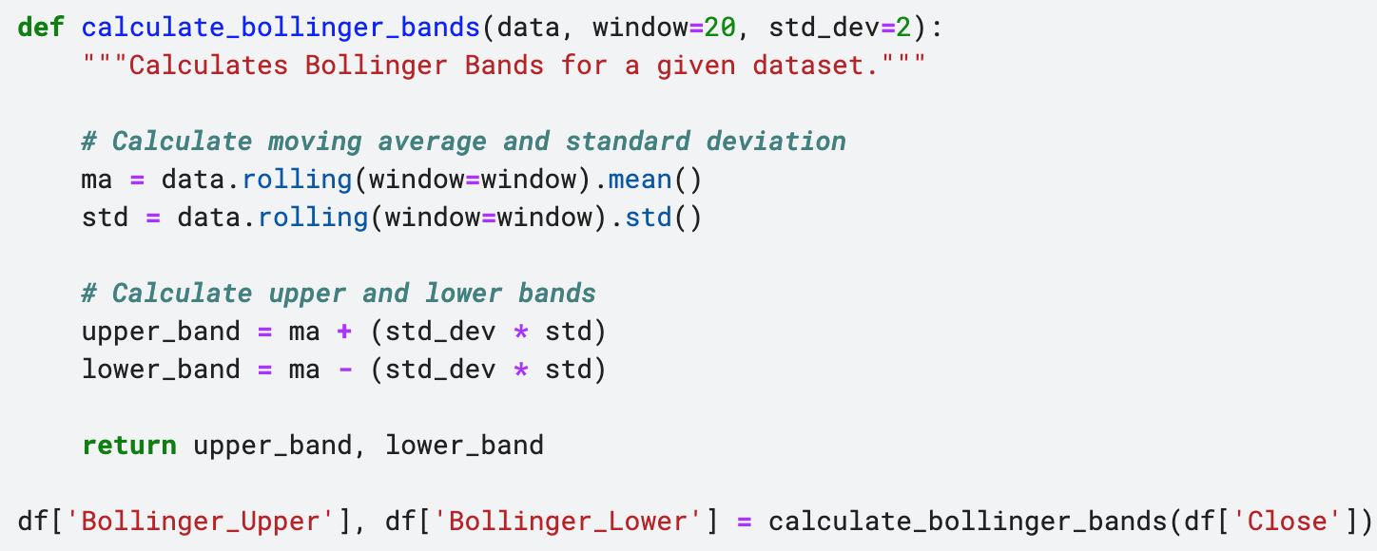
Feature Engineering
e.g. Calculate bollinger brands

Slide 8
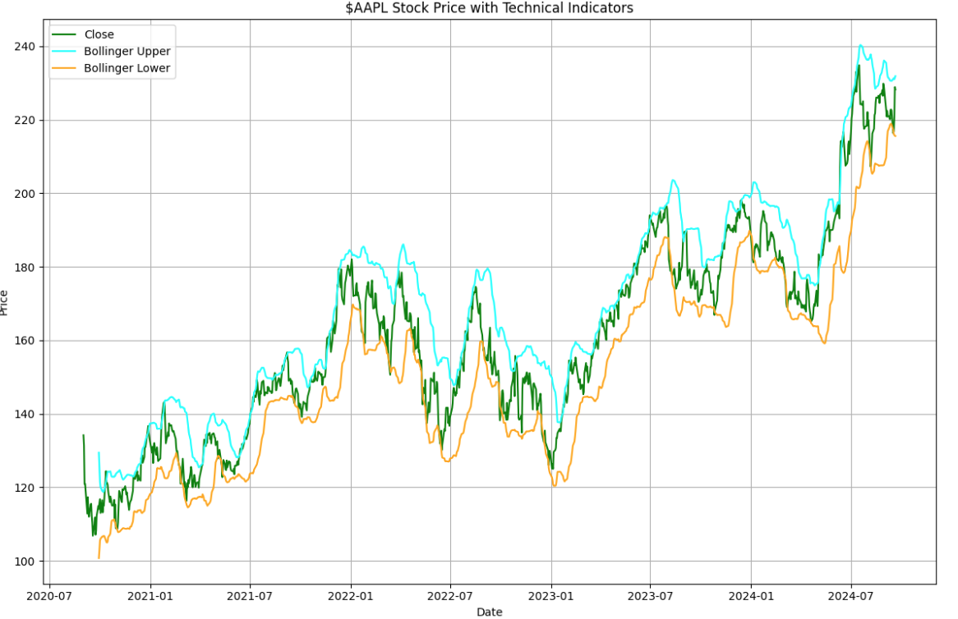
New Features Visualization

Slide 9
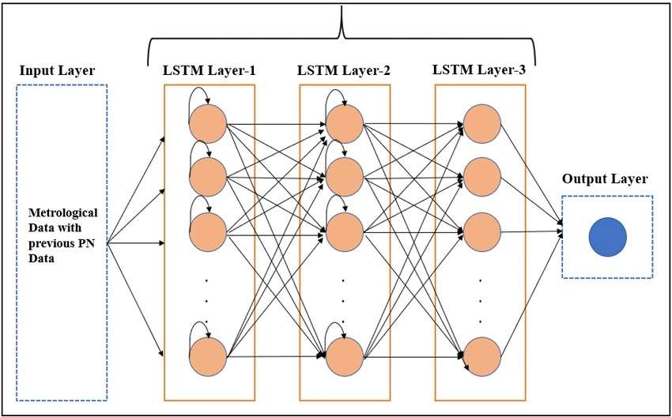
LSTM Model Architecture

Slide 10
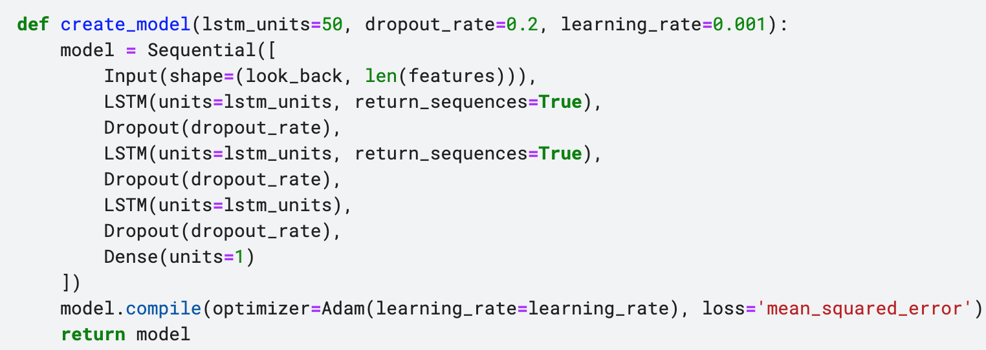
LSTM Model
The LSTM model create as follows:

Slide 11
LSTM Model
Selects relevant features (OHLC, Volume, and some technical indicators).
Normalizes the data using MinMaxScaler.
Creates sequences of historical data (X) and corresponding future prices (y).
Also define the arguments look_back and forecast_horizon:
look_back: Number of past time steps to use for prediction
forecast_horizon: Number of future time steps to predict

Slide 12
LSTM Prediction Results
Result:
Predicted closing price for the next day: $222.02
Mean Absolute Error: $5.14
Analysis:
This means that the actual closing price could be anywhere between $217 and $227.
Actually, the apple stock is rarely fluctuates by more than $5.14 per day, so this high MAE indicates a less accurate prediction.
We need to tune hyperparameter to improve the prediction accuracy.

Slide 13
Hyperparameter Tuning
The Impact of Hyperparameters:
LSTM Units: The number of units in the LSTM layer determines the model's capacity to capture complex temporal dependencies.
Dropout Rate: Introduces randomness into the model's training process, preventing overfitting by dropping out neurons during training.
Learning Rate: Controls the step size taken during optimization.
Batch Size: Determines the number of samples processed in a single iteration during training.
Epochs: Represents the number of complete passes through the entire training dataset.

Slide 14
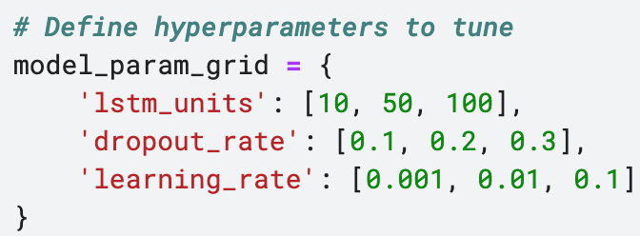
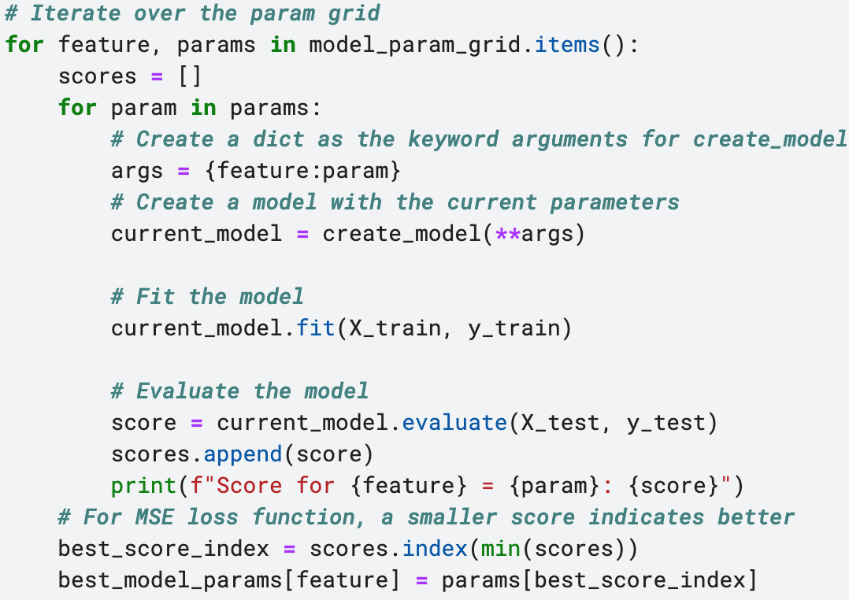
Hyperparameter Tuning
As we used MSE loss function, a smaller score indicates this param value is better.

Slide 15
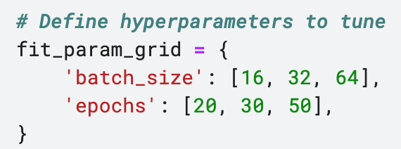
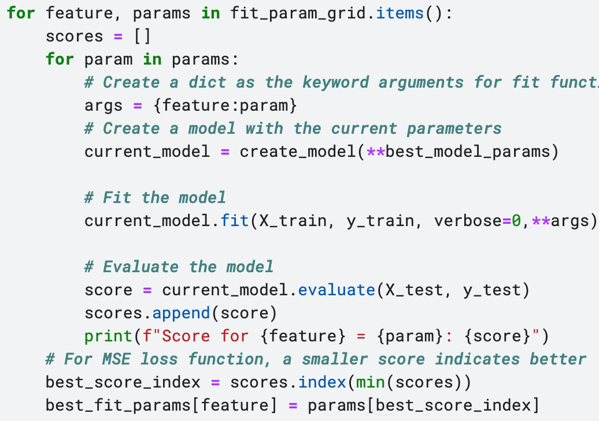
Hyperparameter Tuning

Slide 16
Hyperparameter Tuning Results
Result:
Best model params: {'lstm_units': 50, 'dropout_rate': 0.2, 'learning_rate': 0.01}
Analysis:
The model benefits from a relatively large number of LSTM units.
A dropout rate of 0.2 indicates that 20% of neurons are randomly dropped out during training
A learning rate of 0.01 suggests that the model requires a cautious approach to optimization

Slide 17
Hyperparameter Tuning Results
Result:
Best fit params: {'batch_size': 16, 'epochs': 50}
Analysis:
For given dataset, a smaller batch size could get better results.
More epochs can improve model accuracy but increase training time and risk overfitting.

Slide 18
Optimized Model Prediction Results
Result:
Predicted closing price for the next day: $220.86
Mean Absolute Error: $2.45
Analysis:
Hyperparameter tuning effectively reduced the Mean Absolute Error (MAE) from 5.14 to 2.45, indicating a substantial improvement in the model's performance.
The tuning process likely identified optimal combinations of LSTM units, dropout rate, learning rate, batch size, and number of epochs that contributed to the improved accuracy.

Slide 19
Conclusion
This project successfully demonstrated the application of Long Short-Term Memory (LSTM) networks for predicting future Apple stock prices.
However, the stock market is inherently volatile, and predicting future prices with high accuracy remains a challenging task, while LSTM networks are powerful, they can be computationally expensive and may require significant training time.
Further, we can explore combining LSTM networks with other deep learning techniques

Slide 20
Thanks!

